Slide 1
www.MindMate.org.uk

Slide 2
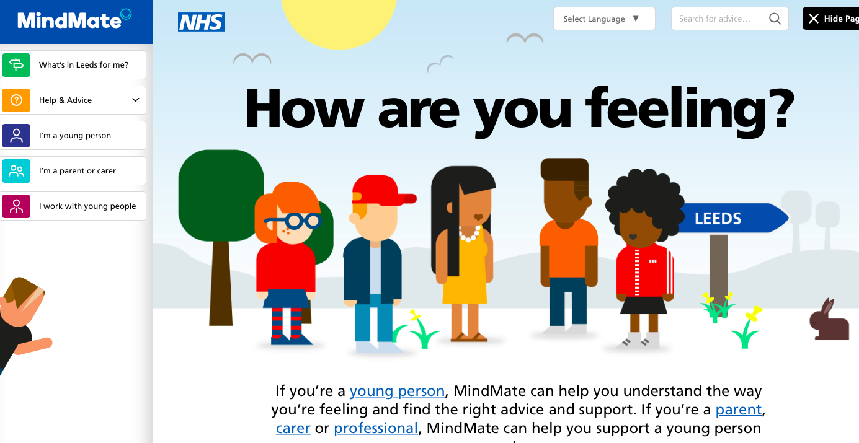
www.mindmate.org.uk

Slide 3
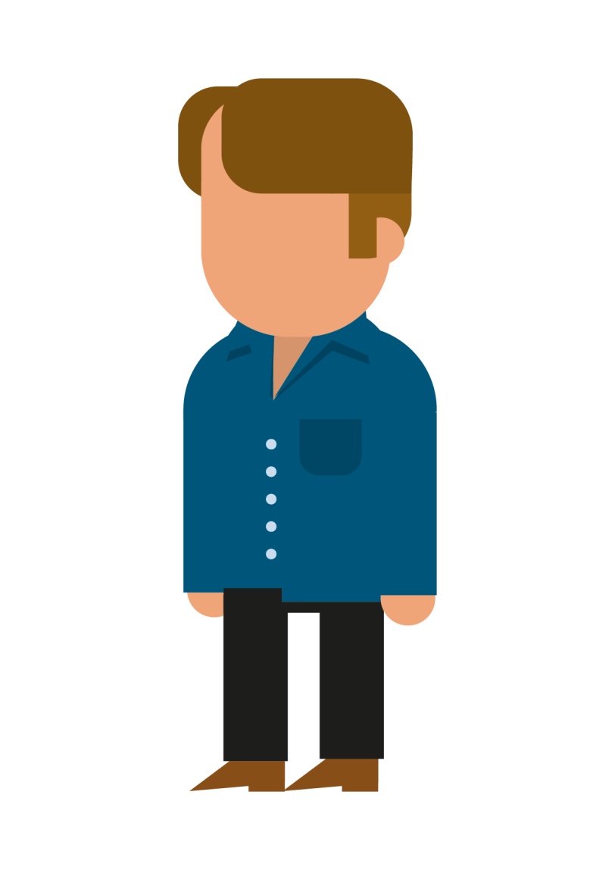
www.mindmate.org.uk who’s it for?
Primarily young people in Leeds (approx 12-19)
those who don’t identify as needing support with mental health, or those who feel they are struggling a bit.
those already using services; with a mental health diagnosis; on a waiting list
Families
Professionals

Slide 4
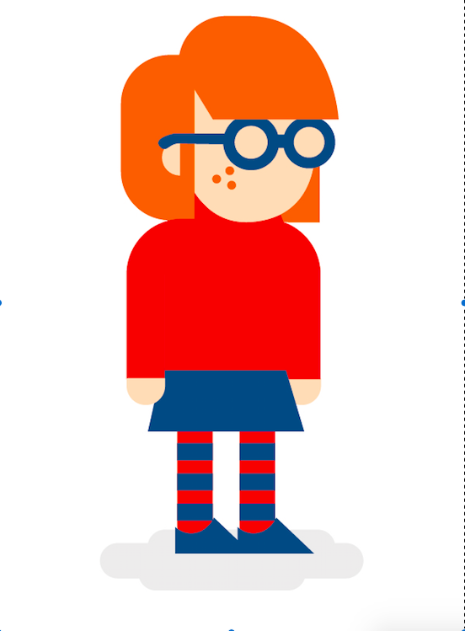
KEY MESSAGES
We all have mental health; sometimes this is good and sometimes not so good
It’s good to know what you can control in your life, and that you have some scope to make changes
It’s normal to have difficult feelings and that is OK. Sometimes it’s hard to cope with these difficult feelings and you might need to seek support
There are people to talk to when times get tough

Slide 5
MindMate on-going engagement
Young people have been involved right from first discussions about the site
Commissioning design company
First discussions about ‘look and feel’
Helping to write copy, find the best web links and resources, testing for glitches
Formal approval process of all content on the site in full progress
Now working on further developments alongside stakeholders

Slide 6
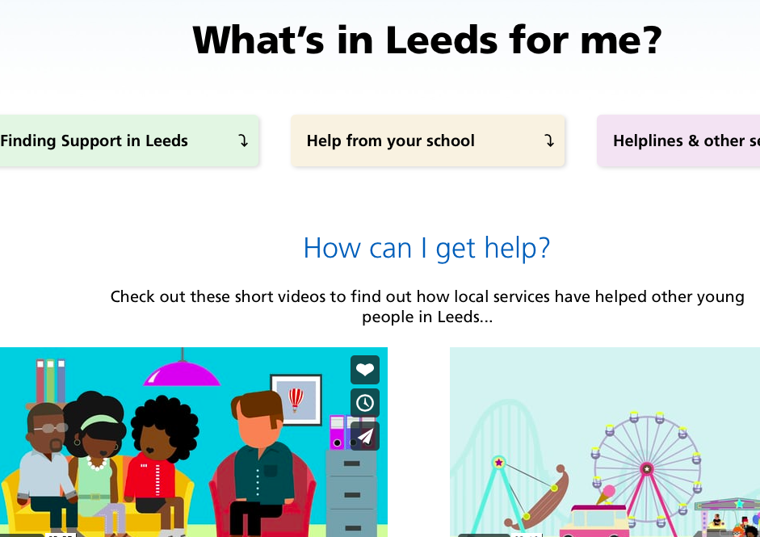
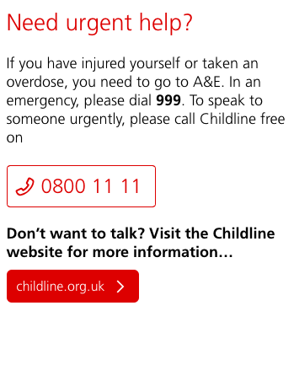
Information on support in Leeds

Slide 7
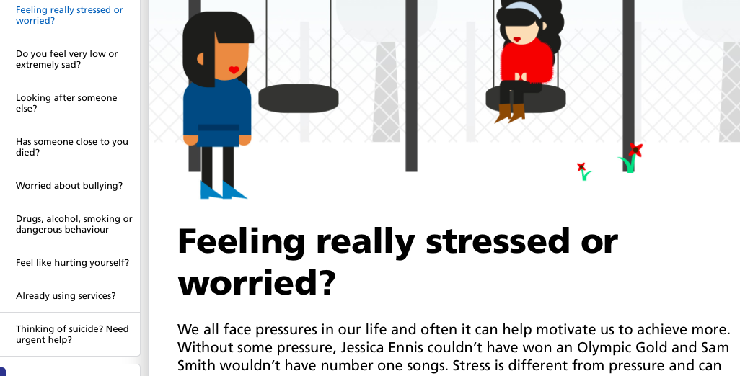
Information on different issues

Slide 8
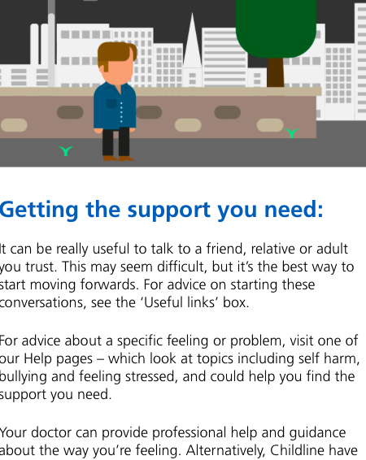
Tips for good mental health

Slide 9
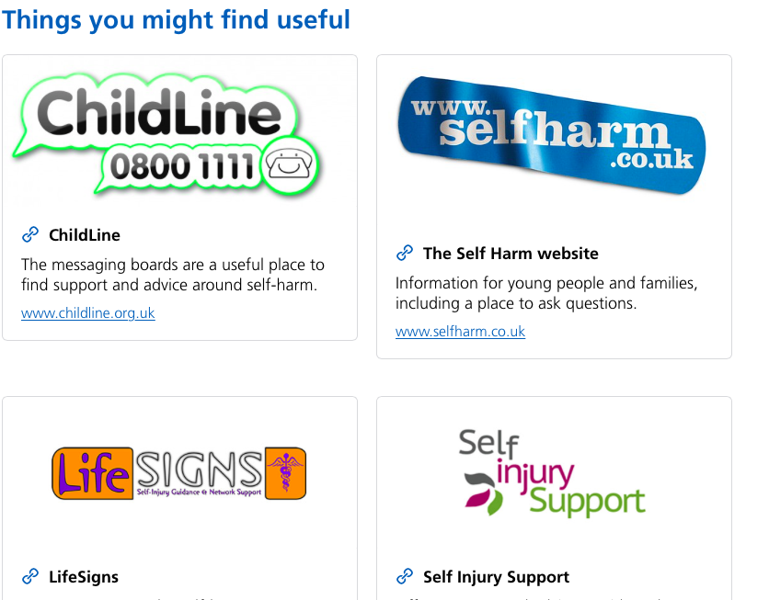
Links to other sites

Slide 10
…further developments

Slide 11
IN THE PIPELINE…
Parent pages and resources
Resource bank for workers
More on for 16+
Interactive tools ‘stresspot’ and ‘find your MindMates’
Develop ‘healthy minds’ pages

Slide 12
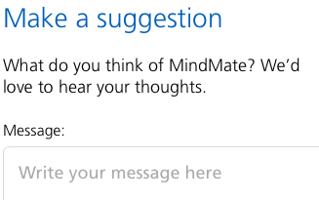
Get involved!
Contact Liz Neill, Common Room
07496 494679
@Liz_CommonRoom
Facebook Liz CommonRoom
www.commonroom.uk.com

