Slide 1
Deaf Awareness Week
2nd to 8th May 2016

Slide 2
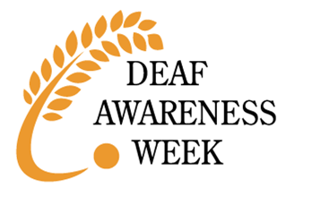

Slide 3
The theme for this year’s Deaf Awareness Week is…
Common Purpose
Common Purpose means everyone who meets or works with or knows a deaf person working together to make sure the deaf person can ACHIEVE THEIR POTENTIAL.

Slide 4
Golden Rule:
Deaf people are NOT stupid!
They just can’t hear, which means they don’t pick up information as quickly and easily.

Slide 5
Communicating with a deaf person
Make sure you are facing the deaf person.

Slide 6
Communicating with a deaf person
Don’t turn away while you’re speaking.

Slide 7
Communicating with a deaf person
Speak clearly and normally – don’t shout!

Slide 8
Communicating with a deaf person
Repeat yourself if you need to.

Slide 9
Communicating with a deaf person
Don’t give up!

Slide 10
Communicating with a deaf person
Never say “Oh, it doesn’t matter!”

Slide 11
Communicating with a deaf person
Write it down or draw a picture.

Slide 12
Deaf people can do most things…
except hear!
Here are some examples of successful deaf or hard-of-hearing people…

Slide 13
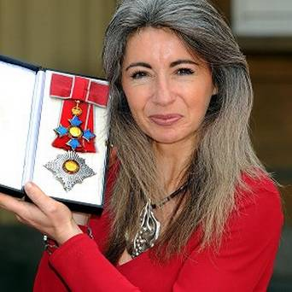
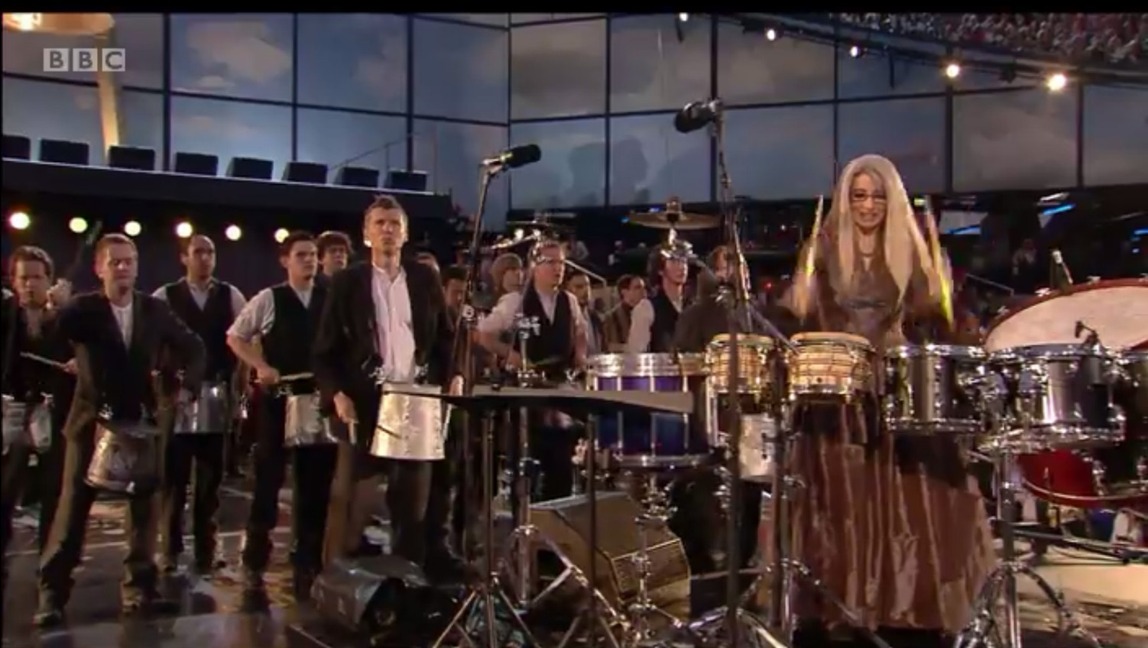
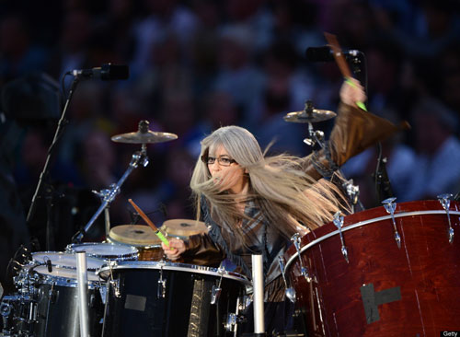
Dame Evelyn Glennie
World – famous percussionist, who led 1,000
drummers at the 2012 Olympic Opening Ceremony.
Completely deaf, since age 12.

Slide 14
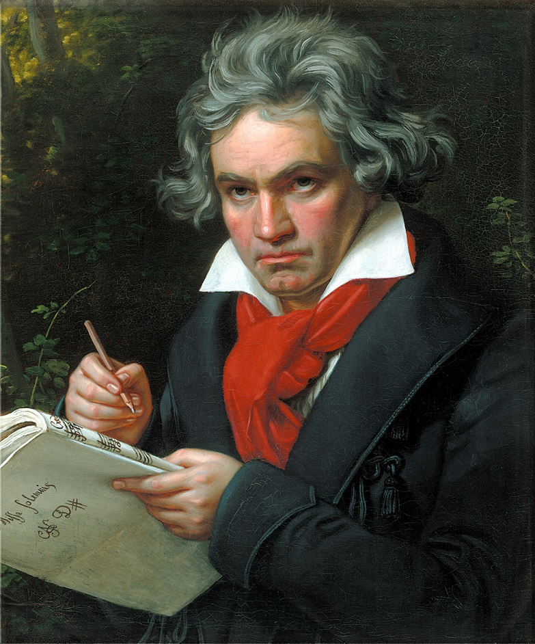
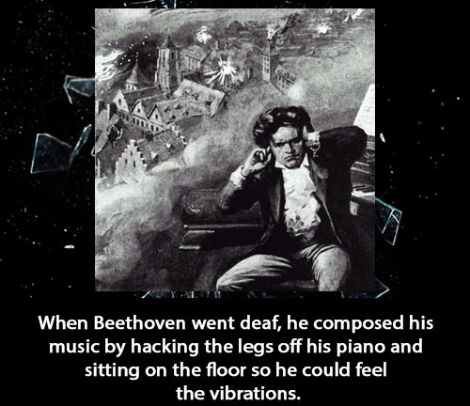
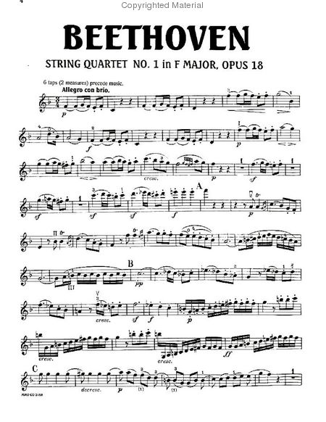
Ludwig Van Beethoven

Slide 15
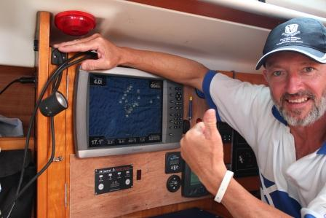
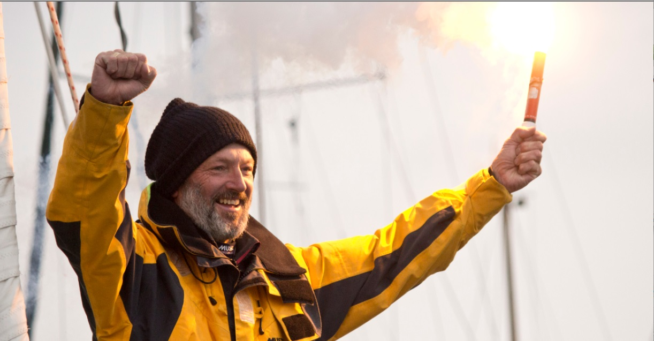
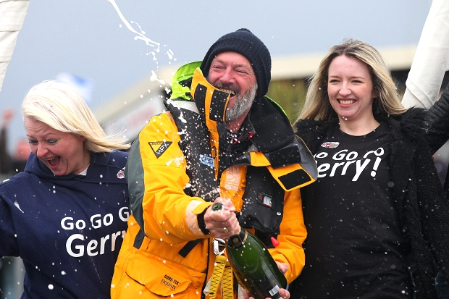
Gerry Hughes
The first deaf man to sail on his own,
all the way around the world.

Slide 16
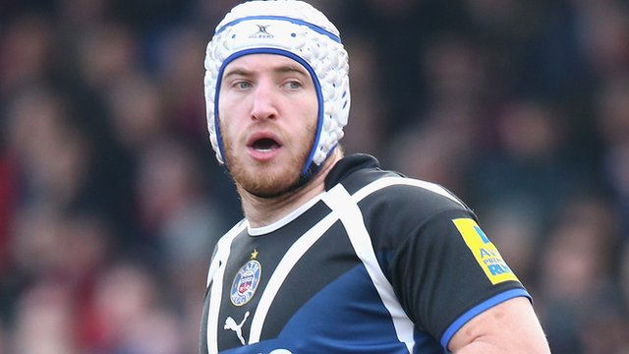
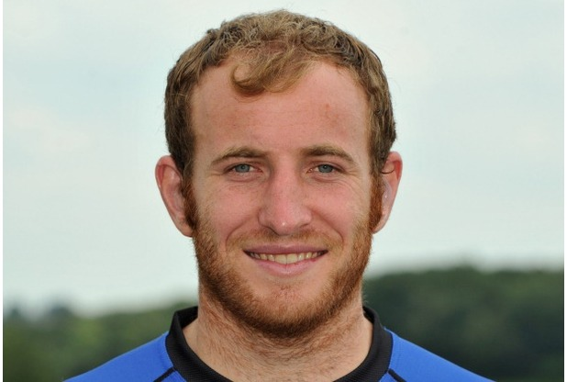
Mat Gilbert
Rugby Union player.
Profoundly deaf.
Currently, playing at Flanker and number eight for Worcester Warriors in the Aviva Premiership.

Slide 17
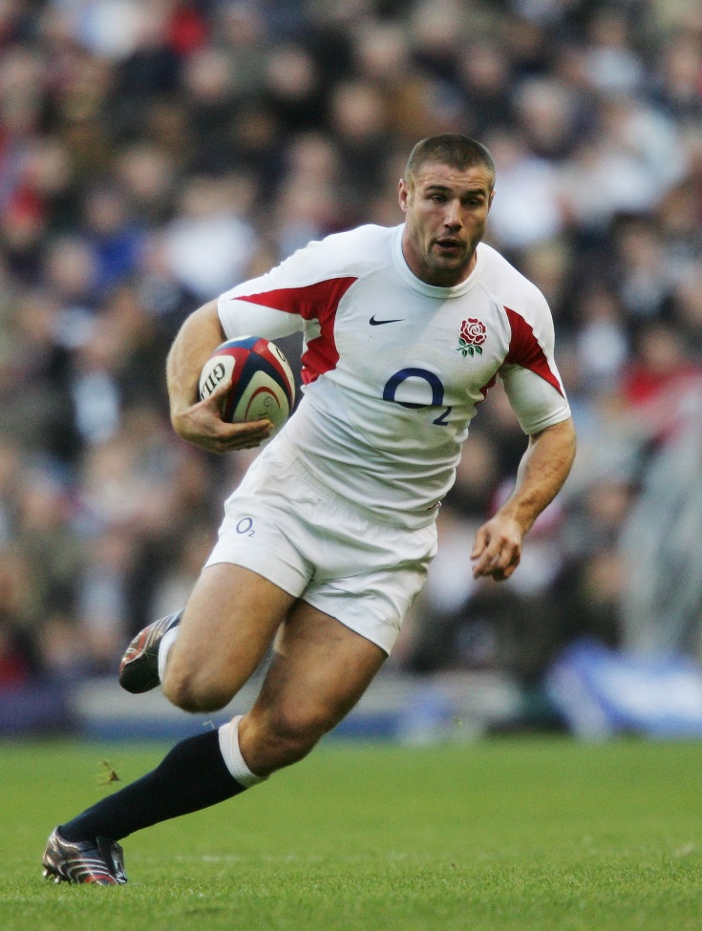
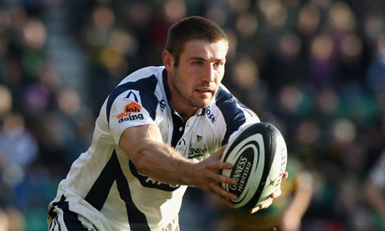
Ben Cohen
Rugby Union player and Strictly Come Dancing contestant.
50% hearing loss in both ears.

Slide 18
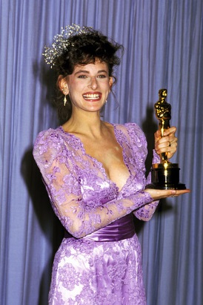
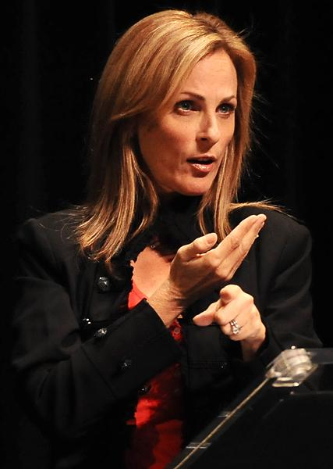
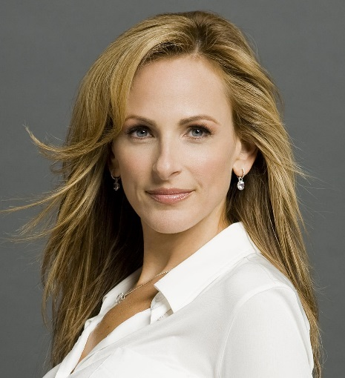
Marlee Matlin
First deaf person to win an Oscar for Best Actress, for ‘Children of a Lesser God’.
Made her acceptance speech in American Sign Language
In many TV shows, such as “CSI”, “ER”, “My Name Is Earl”, “Seinfeld”, “Family Guy” and “Glee”.

Slide 19
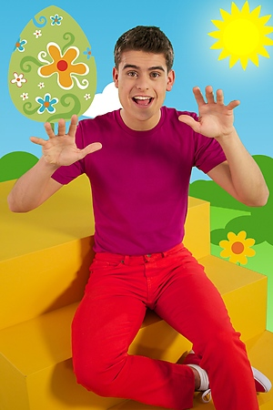
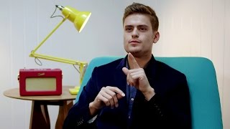
Ashley Kendall
Presenter on ‘Magic Hands’, a show which uses British Sign Language to tell stories to children.
Deaf since birth, and has a deaf family.
He won a ‘Breakthrough Brit BAFTA’ in 2014.

Slide 20
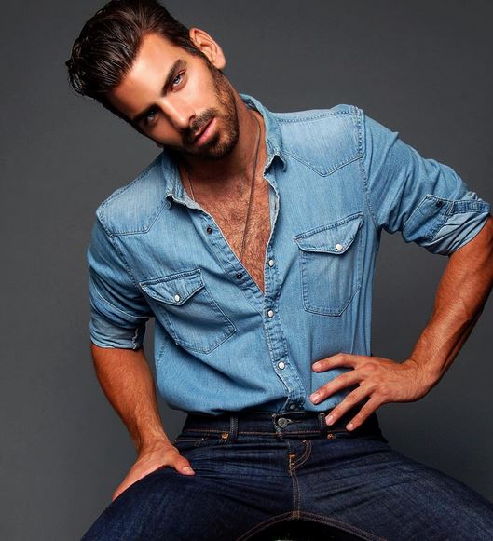
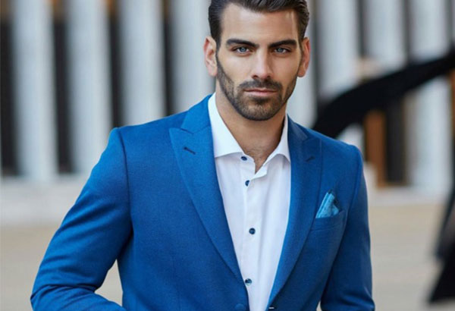
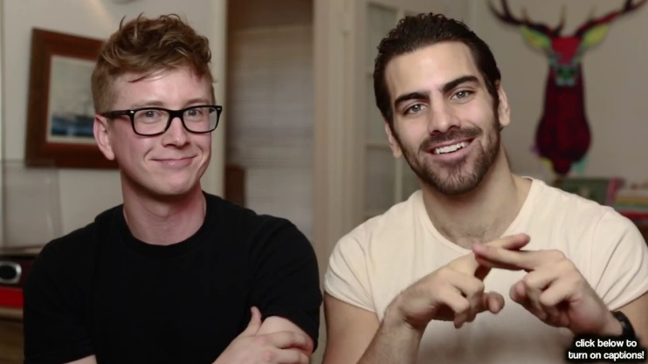
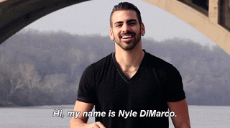
Nyle DiMarco
First Deaf contestant and winner on ‘America’s Next Top Model’.
Deaf since birth, like four generations of his family.
Currently on ‘Dancing With The Stars’. He received the first 10 score of the season.
Campaigns for Deaf Rights with his own charity.

Slide 21
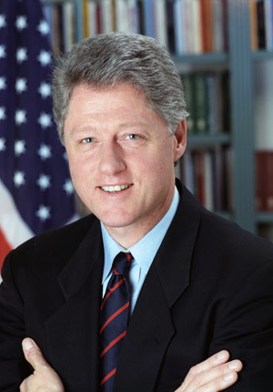
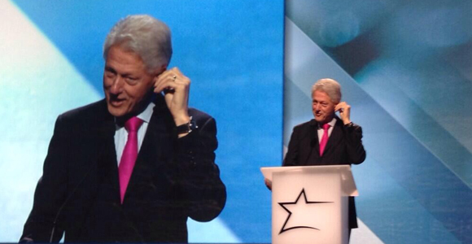
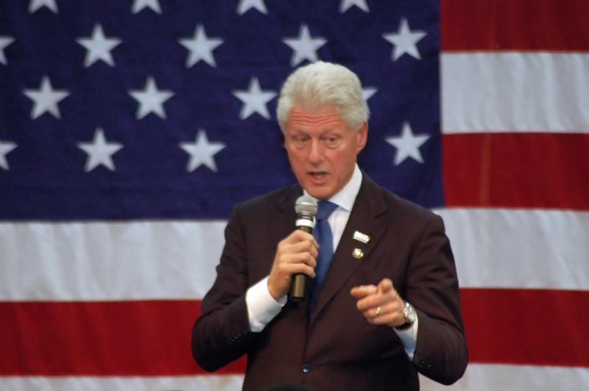
President Bill Clinton
President Clinton started wearing hearing aids in both ears in 1997, while he was president.

Slide 22
Make sure your
common purpose
is including everyone and helping everyone achieve their potential.
Just because communicating might be a little bit more difficult doesn’t mean you should give up!

Slide 23
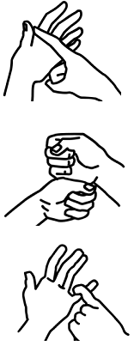
Can you fingerspell your name using BSL?
Drop in to the Reception at Adams Court during
Deaf Awareness Week
(May 2nd – 6th)
To pick up the hand-out and enjoy the display on the wall.

Slide 24
