Slide 1
Supporting children and young people’s social, emotional and mental health in Leeds: the picture at April 2016
Dr Jane Mischenko, Leeds NHS CCGs
Natalie Samuel, Complex Needs Service

Slide 2
WHAT do we mean when we talk about social, emotional and mental health?
Notes:
Everyone has emotional and mental health
“How are you feeling today” (to audience)
The definition offered by the World Health Organisation: when we are in good emotional and mental health, we can cope with the stresses of everyday life, fulfil our potential, and feel good or okay about life and ourselves most of the time.
Our ‘social’ life can really affect our emotional and mental health - the things around us like our family, friends, and the situations we experience in everyday life.
The SEN code of practice (the guidance that supports regulations on supporting special needs) asks us to remember this and to use the term ‘social, emotional and mental health’.
The Department of Health uses the term Mental Health and Wellbeing, also recognising the importance social factors play.
All children will experience difficult times and feelings like anger, anxiety, sadness at some point. This is normal and learning how to cope with these feelings and behave appropriately in response to those feelings, is a normal part of growing up. But if a child or young person feels unable to cope with everyday life, rarely feels okay about life and themselves, and/or cannot fulfil their potential, they need additional support
This may be related to a specific mental health condition, e.g. clinical depression or anorexia. It may be related to something in their social life, like a bereavement, domestic violence, or bullying. It may be linked to other special educational needs, e.g. autism or dyslexia. It may be a combination of these factors; it may have no obvious cause.
This may also affect their behaviour. They may behave in a way that causes or risks causing harm to themselves, to others, or to the things around them. Some may abuse drugs and alcohol or take risks with their sexual wellbeing. They may have poor attendance at school or be excluded from school. These things can have a big impact on their future.

Slide 3
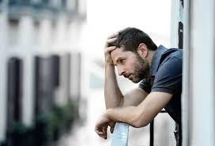
WHY does it matter?
Notes:
A GROWING PROBLEM: There is increasing evidence that this is a growing problem for our children and young people:
The numbers of Children and Young People self-harming and attending A&E is increasing (nationally and in Leeds). With the advent of social media Children and Young People are increasingly exposed to cyberbullying – a new factor in society to deal with. Some figures also suggest that locally, SEMH issues are more prevalent that in other areas of the country: January 2014, 38% of secondary-aged pupils in Leeds identified as having any form of additional need, had SEMH needs; compared to 26% as the national average (DfE, School Census 2014).
Demand for services threatens to outstrip supply – and there is recognition nationally that there has not been enough investment into these services. For example only 0.7% of the NHS budget is spent on CAMHS services.
Some of our most vulnerable children are most likely to be affected: estimates suggest that those in poorer households are three times more likely to be affected, and that 45% of Children Looked After are affected.
EFFECTS ON LIFE OUTCOMES: Research also shows the impact this can have on a child or young person and the possible long term effects on their whole adult life:
Less likely to achieve qualifications: for example the DfE in 2012/13 found that just 1.4% of learners with the most severe SEMH needs achieved 4 GCSEs A*-C, compared to 53% of their peers
Less likely to enter employment after leaving education: the DfE in 2012/13 found 20% were NEET after KS4, compared to 2%.
May continue to have mental health problems into adulthood: Half of adult mental illness starts before the age of 15 and 75% by the age of 18 (Royal College of Paediatrics and Child Health)

Slide 4
National Policy
Notes:
A CHANGING NATIONAL AGENDA:
“Future in Mind” Publication from the national taskforce looking into CYP Mental Health and Wellbeing
Led to all areas needing local Transformation Plans for CYP Mental Health and Wellbeing (prevention to specialist services) and additional funds allocated to support these. In Leeds we have a plan and receive £1.5m additional funds in 2015/16
New legislation: the Children and Families Act 2014 introduced major changes to all services supporting special educational needs. A new Code of Practice defined ‘SEMH needs’ and required LAs and health agencies to:
publish details of the local offer of SEMH services
Demonstrate that services are equitable and consistent across the city
Set out expectations of all local schools

Slide 5
WHY does it matter?
Notes:
A COMPLEX SYSTEM THAT IS DIFFICULT TO UNDERSTAND AND NAVIGATE:
In 2015 CYP, Families and the children’s workforce in Leeds reported that:
Pathways to services are not clear enough
There is not enough information about what services are available and how to get them
It takes too long to access services
There may not be enough of some services to meet local needs
There may be gaps in services
Some services may not be high quality
There may be a lack of consistency across services in different areas of the city, which is not equitable

Slide 6
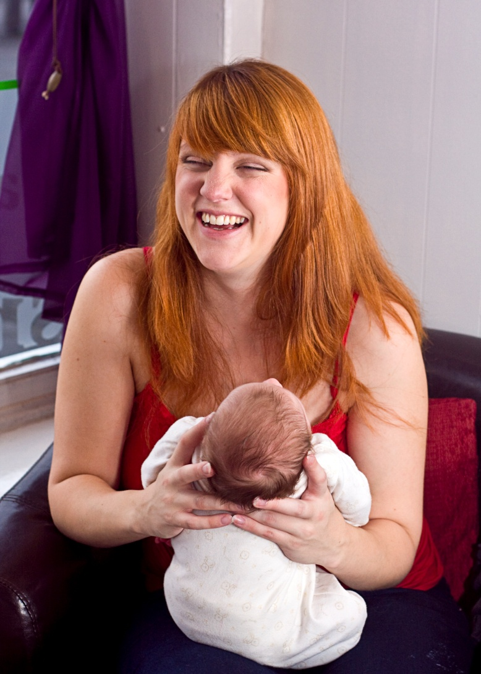
WHAT have we been doing in Leeds?
Notes:
Some key elements of the LTP
Primary Prevention – the impact of perinatal mental health needs increasingly recognised – biggest indicator of anxiety and depression in adolescents is a mother having had depression whilst pregnant!
Working to ensure women are supported at the moment – key as part of bonding and attachment
This feeds into our city priority to ensure all our children have the best start in life

Slide 7
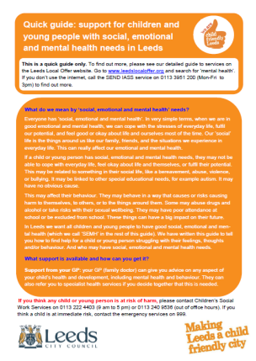
WHAT have we been doing in Leeds?
www.mindmate.org.uk
Notes:
In response to the feedback that the system is too complex we have local guides explaining the Local Offer
And the MindMate website which YP have been involved in co-producing – this helps explain what is available – in narrative and in animations – take a look – Liz Neill is going to be talking through this work later

Slide 8
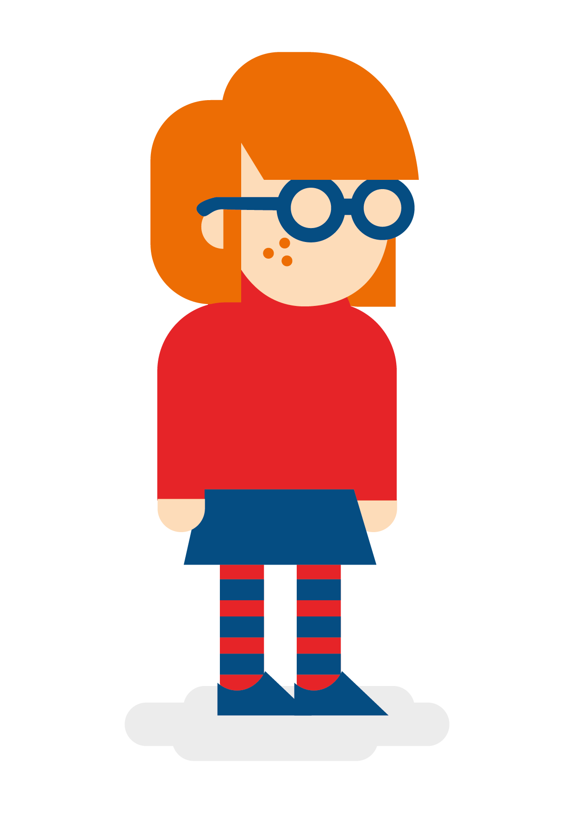
Key aims of the review
WHAT have we been doing in Leeds?
Promoting mental wellbeing and early support
High quality services and quicker access: refining our local targeted services to provide early help as soon as possible;
And re-designing our specialist services for those with the most complex needs and those in crisis
mechanisms; quality assurance of services; robust method to measure outcomes
Effective communications with everyone affected
Notes:
Promoting emotional and mental well-being and early support for ALL children and young people by:
Supporting parents of young babies (Best Start)
Creating nurturing environments in schools and other universal settings to promote emotional resilience
Providing training and development opportunities for people working with children and young people
establishing ‘champions’ in all Leeds children centres and schools
campaigning to challenge stigma
Clear, efficient pathways for timely access to services
Reducing waiting times – a key priority for CYP
Introducing the new Single Point of Access
Working with clusters and AIPs
Providing a new specialist children’s eating disorder service
Developing crisis support
Effective communications with everyone affected

Slide 9
HOW have we been doing this?
Working together across Education, Health and Social Care
Working with children, young people, families and practitioners
Developing the Leeds strategy and Transformation Plan
Planning how to best use funding available to support changes

Slide 10
HOW will we make things happen?
Strategic boards to monitor progress and report to the Children’s Trust Board & Health & Wellbeing Board
Joint working groups
Ongoing engagement with everyone affected by the work
Regular communications to keep everyone informed
Notes:
Plans to merge the boards in a year once the specialist educational offer is developed (Academy Trust) –
Meanwhile many common areas of working priorities which is reflected in the work-stream groups – the vast majority of which are joint working groups and are co-chaired by NHS and LCC colleagues
The Strategy and plan are to be delivered over 5-years and so ongoing engagement and development
Recognise need for lots of communication

Slide 11
HOW will we know if we are making a difference?
Developing a new way to measure and monitor shared outcomes: piloting new methods with support from the Child Outcomes Research Consortium
Monitoring satisfaction with services: do parents and carers, and children and young people, think we have made a difference?
Monitoring the number of exclusions: have we reduced the number of children and young people being excluded from education or not attending school because of SEMH needs?
Notes:
Lucky to be part of national pilot –one of 7 areas – exploring data linkage and a few key shared outcomes

Slide 12
HOW to find out more:
Check the Leeds Local website for updates www.leedslocaloffer.org.uk (search for ‘SEMH’)
Look at our MindMate website www.mindmate.org.uk
Look at our Local Transformation Plan http://www.leedssouthandeastccg.nhs.uk/Downloads/Our%20publication/Leeds%20LTP%20FINALNov15%20formatted.pdf
Colleagues in schools: check the ‘Inclusion’ section of the Education Hub for updates
Sign up for the complex needs service newsletter – email bpteam@leeds.gov.uk
Get in touch: email bpteam@leeds.gov.uk with your query and we will make sure it gets to the right person to answer the question.

Slide 13
Thanks for listening!

